Slide 1


Hospital Oversight
Present by: Lukhi Laksh Nareshbhai
Kathiriya Bhautik Bipinchandra
Jadav Darshil Mahendrabhai
Guide by: Ms. Divya Gupta

Slide 2
1.Introduction
Project Title | Hospital Oversight
Project Description | The Hospital Oversight project for a dental hospital is a web-based platform designed to optimize hospital management. It streamlines patient registration, appointment scheduling, dental treatment records, billing, and communication between doctors and patients. The system improves efficiency, enhances patient care, and provides a seamless experience for both staff and patients.
Name of Institute | Atmanand Saraswati Science Collage
Project Category Front-End Tool | HTML, CSS, Javascript,Bootstrap
Back-End Tool | PHP, MYSQL
Project Guide | Ms. Divya Gupta
Submitted By | Laksh Lukhi Nareshbhai

Slide 3
2.Environment Description
2.1 Hardware Requirements
Operating System | Microsoft windows 10
Frontend | HTML,CSS,JAVASCRIPT
Backend | PHP
Scripting language | Javascript
Database | MYSQL
2.2 Software Requirements
Processor | Intel Core i7
RAM | 8.0 GB
Hard Disk | 477 GB
Disk Space | 10 GB Minimum

Slide 4
3.System Analysis and Planning
3.1 Existing System and Its Drawbacks
The current systems used in dental hospitals for monitoring and evaluation are often inadequate in several aspects:
Manual Processes: The reliance on paper-based records and manual data entry increases the risk of errors, data loss, and inefficiencies in accessing patient information.
Limited Patient Feedback Mechanisms: Existing systems may not effectively capture patient feedback on their experiences, leading to a gap in understanding patient satisfaction and areas for improvement.
Insufficient Integration: The lack of integration between different systems (e.g., appointment scheduling, billing, patient records) can lead to fragmented information and hinder comprehensive patient care.

Slide 5
3.2 Feasibility Study
A feasibility study is essential to evaluate the practicality and potential success of implementing the Hospital Oversight project. The study will consider various factors:
Technical Feasibility:
Assess the current technology infrastructure and its capacity to support the proposed system.
Economic Feasibility:
Analyze the costs associated with implementing the new system, including hardware, software, training, and ongoing maintenance.
Operational Feasibility:
Evaluate the organizational structure and readiness of staff to adopt the new system.
Schedule Feasibility:
Establish a timeline for implementation, including phases for system development, testing, and rollout.

Slide 6
4.Proposed System
4.1Scope
Web-Based Platform: Develop an intuitive, web-based system that is accessible via any device with internet connectivity, enabling stakeholders to use the system anytime, anywhere.
Patient Management: Enable features for patients to book appointments, view their medical history, access treatment plans, and communicate with healthcare providers directly through a secure messaging system.
Doctor Management: Equip doctors with tools to manage their schedules, access patient records, document treatment plans, and communicate with other healthcare professionals. This includes functionality for telemedicine consultations to accommodate remote patient care.
Administrative Management: Enhancing operational oversight, compliance monitoring, and reporting for improved hospital administration.
Appointment Scheduling: Implement a centralized appointment scheduling system that allows patients to book, reschedule, or cancel appointments, with notifications sent to both patients and doctors.
Search and Filter Options: Provide robust search and filter functionalities that allow patients to find healthcare providers, services, and treatment options based on various criteria.
Data Analytics and Reporting: Implement analytics tools to monitor user interactions and preferences, enabling data-driven decision-making for improving patient care and operational efficiency.

Slide 7

4.2Project Modules
The "Hospital Oversight" system is organized into specific modules designed to address the needs of patients, doctors, and administrative staff, ensuring efficient management and operational oversight within the dental hospital.

Slide 8
PATIENT MODULE:
Patient Access:
Patients can visit the portal to explore available dental services, treatments, and educational resources about oral health.
Registration:
The registration module allows new patients to create an account. Patients must provide personal information such as name, email, phone number, and password to access additional features and personalized services.
Login:
This module enables registered patients to log in to their accounts. After logging in, patients can access their medical history, schedule appointments, and manage treatment plans.
Appointment Management:
Patients can view available appointment slots, schedule new appointments, reschedule existing ones, and cancel appointments through this module.
Profile Management:
Patients can update their personal information, including contact details and medical history, ensuring that their records are accurate and up-to-date.

Slide 9
DOCTOR MODULE:
Doctor Dashboard:
Doctors have access to a dashboard displaying their schedule, upcoming appointments, and patient lists, providing a comprehensive view of their daily activities.
Patient Management:
This module allows doctors to view detailed patient profiles, including medical history, treatment records, and appointment details, facilitating personalized care.
Appointment Scheduling:
Doctors can manage their appointment slots, accept or decline patient appointments, and reschedule as necessary to ensure optimal patient flow.

Slide 10
ADMIN MODULE:
Admin Dashboard:
The admin dashboard provides an overview of the hospital's operational metrics, including patient registrations, appointment statistics, and financial summaries.
Patient Management:
Admins can manage patient and doctor accounts, including creating new accounts, updating information, and deactivating accounts as needed.
Appointment Management:
Admins can view all scheduled appointments, manage schedules for doctors, and handle any conflicts or issues that may arise.
Reports and Analytics:
Admins can generate various reports, including patient demographics, service usage statistics, and financial performance, providing insights for strategic planning.
Communication Management:
Admins can oversee communication with patients and staff, ensuring timely responses to inquiries and maintaining effective communication flow.
System Settings and Configuration:
This module allows admins to configure system settings, manage user roles and permissions, and maintain overall system integrity and security.

Slide 11
4.3Module wise objectives and functionalities
The "Hospital Oversight" system aims to enhance the management of dental care services, improving efficiency and patient satisfaction through various functionalities in the patient, doctor, and admin modules.

Slide 12
PATIENT MODULE:
Comprehensive Service Range:
Provide a wide selection of dental services and treatments, including preventive care, cosmetic dentistry, orthodontics, and oral surgery, catering to diverse patient needs.
Appointment Scheduling:
Enable patients to easily book, reschedule, or cancel appointments through an intuitive interface, ensuring convenience and accessibility.
Detailed Appointment Information:
Offer comprehensive descriptions of dental procedures, including benefits, risks, recovery, and costs, helping patients make informed decisions about their dental care.
Secure Patient Records:
Implement secure storage for patient medical histories, treatment plans, and prescriptions, ensuring confidentiality and easy access for both patients and healthcare providers.
Patient Accounts and Profiles:
Allow patients to create and manage personal accounts, saving their preferences, appointment history, and treatment details for future reference.
Book Appointment for Treatments:
Provide real-time tracking of treatment progress and follow-up appointments, ensuring patients stay informed about their dental care journey.

Slide 13
DOCTOR MODULE:
Doctor Dashboard:
Provide a personalized dashboard for doctors to manage their schedules, view patient appointments, and access treatment histories at a glance.
Patient Management:
Allow doctors to view and update patient profiles, including medical histories, treatment records, and notes, facilitating personalized patient care.
Appointment Management:
Enable doctors to manage their appointment schedules, accept or decline patient bookings, and set availability, ensuring efficient time management.
Treatment Documentation:
Allow doctors to document treatments performed, update patient care plans, and ensure accurate records are maintained for every patient.
Analytics and Reporting:
Enable doctors to access performance metrics, including patient outcomes and service utilization, for ongoing improvement and informed decision-making.

Slide 14
ADMIN MODULE:
Admin Dashboard:
Provide an overview of hospital operations, including patient statistics, appointment schedules, and financial reports, facilitating effective management.
Patient Management:
Allow admins to manage patient and doctor accounts, including the ability to add, edit, or deactivate accounts as necessary for security and efficiency.
Appointment Oversight:
Enable admins to oversee all scheduled appointments, manage conflicts, and ensure that the scheduling system operates smoothly.
Reports and Analytics:
Generate comprehensive reports on patient demographics, service utilization, and financial performance, providing insights for strategic planning.
System Configuration:
Allow admins to configure system settings, manage user roles and permissions, and ensure overall system security and integrity.

Slide 15
5. System Design
5.1 Input Design
When discussing input design for hospital oversight in the context of web pages like the Home Page, Services Page, About Us Page, Contact Us Page, and Gallery Page, the design is focused on how data and information are presented through a hospital oversight. Below is a breakdown of what input design might involve for each page:
1. Home Page:
Input Fields:
Login/Sign-up Forms: For patients or staff to log in to their accounts or register for services like online consultations or medical record access.
Design Considerations:
The homepage should be intuitive, offering quick access to important sections such as appointments, contact information, and emergency services.
Input validation for login credentials or registration fields (e.g., email, password).
2. Services Page:
Design Considerations:
Clear labeling of medical services, with forms that validate input (e.g., ensuring patients select valid appointment dates and available doctors).

Slide 16
3.About Us Page:
Design Considerations:
Simple and informative, with minimal need for input, but an easy-to-navigate structure.
Emphasis on presenting essential details like hospital accreditation, leadership, and core values.
4. Contact Us Page:
Input Fields:
Contact Form: Typically includes fields for the user's name, email address, phone number, and a message or inquiry section.
Design Considerations:
Input validation to ensure accurate contact details (e.g., phone number format, email verification).
5. Gallery Page:
Input Fields:
Share Buttons: Input options for users to share content from the gallery on social media platforms.
Design Considerations:
Minimal input needed, but users should be able to navigate easily through the images.

Slide 17
5.2 Output Design
Output design in hospital oversight focuses on how information is displayed to users, ensuring that the data presented on the website or system interface is clear, accessible, and meaningful. Here's a breakdown of what output design might involve for each of the pages:
1. Home Page:
Output Elements:
Welcome Banner or Key Notices: Displays important announcements, such as new services,our Doctor(Best Expert Dentist).
Navigation Menu: Clearly displays links to various sections like services, about us, contact information, and patient portals.
Login/Account Status: If patient log in, the homepage should output a personalized dashboard with relevant information such as upcoming appointments information.
Design Considerations:
Ensure information is presented clearly, updating as users interact with the page (e.g., displaying upcoming appointment details after login).
Mobile-friendly layout to ensure information is displayed correctly on all devices.

Slide 18
2. Services Page:
Design Considerations:
Structured layout to help Patient easily find and understand the services offered by the hospital.
User-friendly design for appointment confirmation and receipt, ideally with options to print or save details.
3. About Us Page:
Output Elements:
Hospital Information: Outputs key information about the hospital's history, mission, vision, and management in a readable, structured format.
Doctor Profiles: Short biographies or profiles of key hospital personnel such as directors, senior doctors, and administrators.
Design Considerations:
Information should be visually appealing and easy to navigate, with sections or tabs for each piece of content.

Slide 19
4. Contact Us Page:
Output Elements:
Contact Information: Clearly outputs hospital contact details including phone numbers, email addresses, and physical addresses for different departments.
Map and Directions: Displays an interactive map that provides the hospital's location, including directions and nearby landmarks.
Design Considerations:
The contact details should be easily accessible, with options for quick action (e.g., one-click calling on mobile).
5. Gallery Page:
Output Elements:
Images : Outputs a gallery of photos showcasing hospital facilities, staff, patient care events, or special programs.
Design Considerations:
High-quality visuals with appropriate formatting and responsive design to ensure images load well on different devices.
Lightbox or zoom-in features for a more detailed view of images.

Slide 20
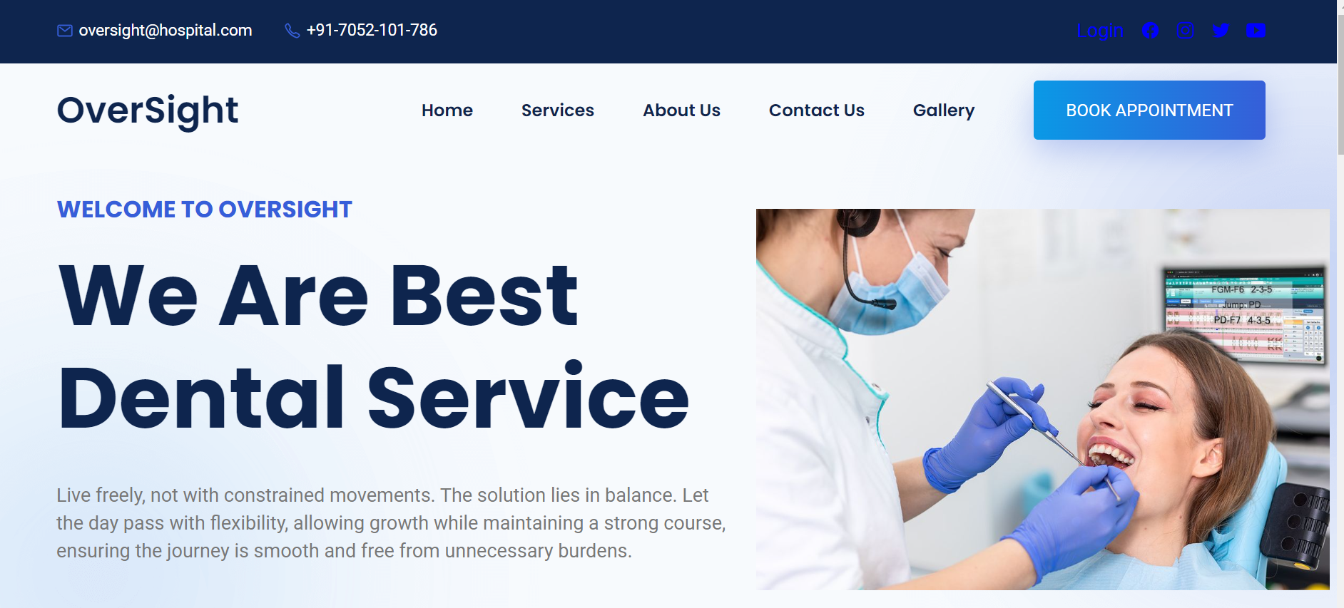
5.3 Screenshots of the system
Home Page

Slide 21
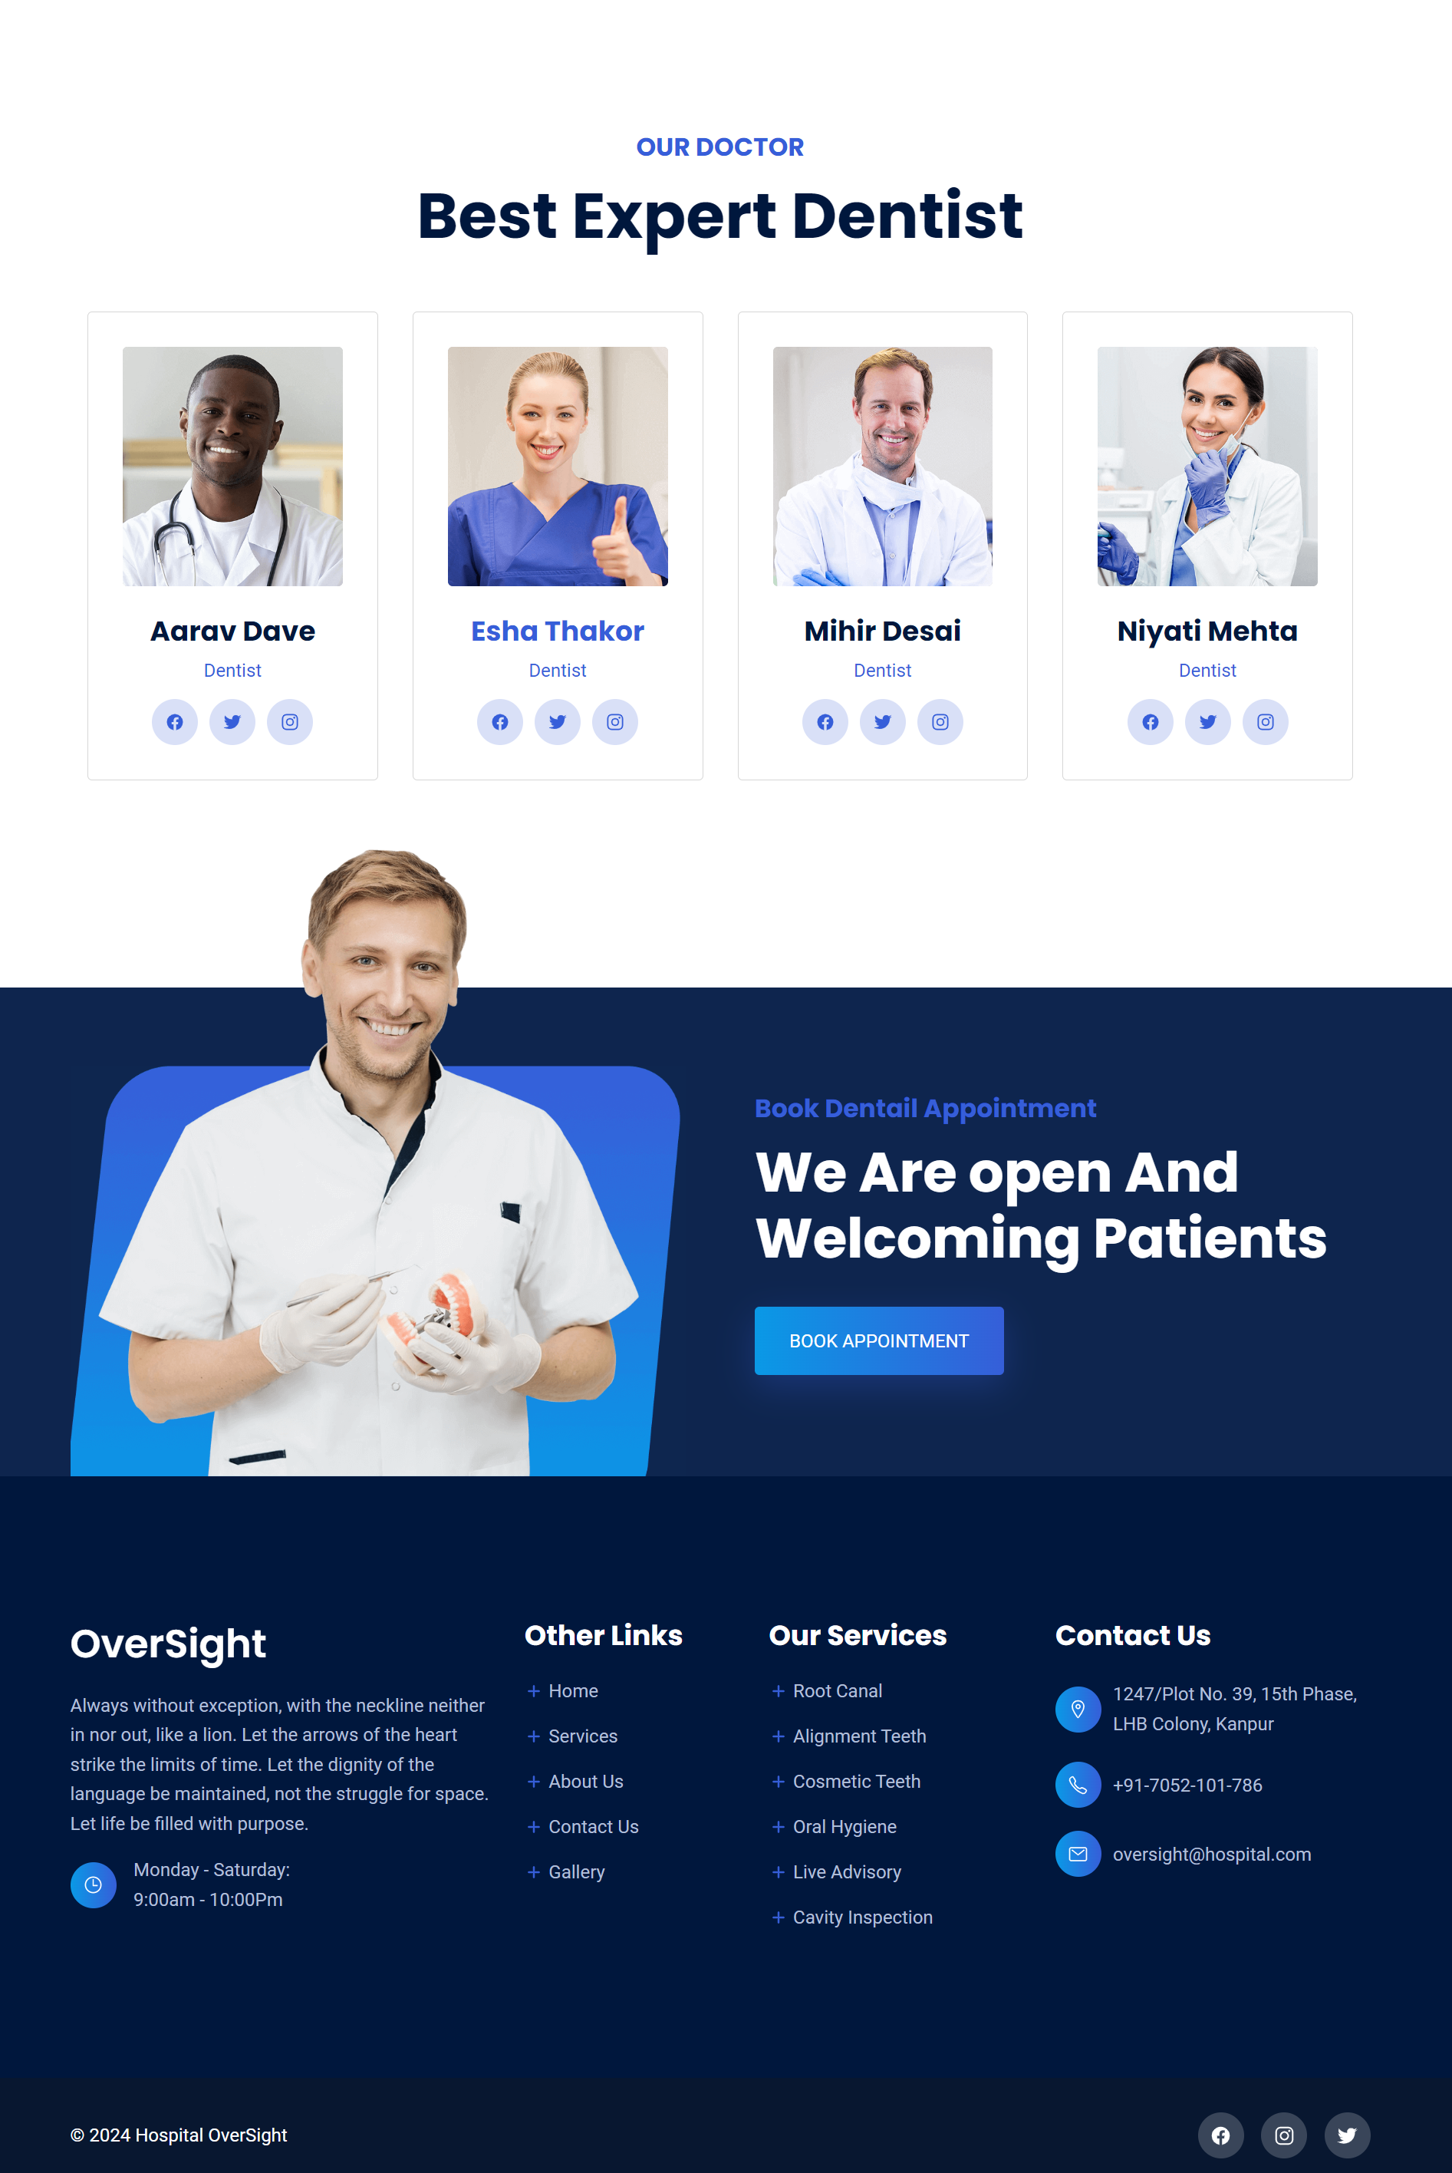

Slide 22
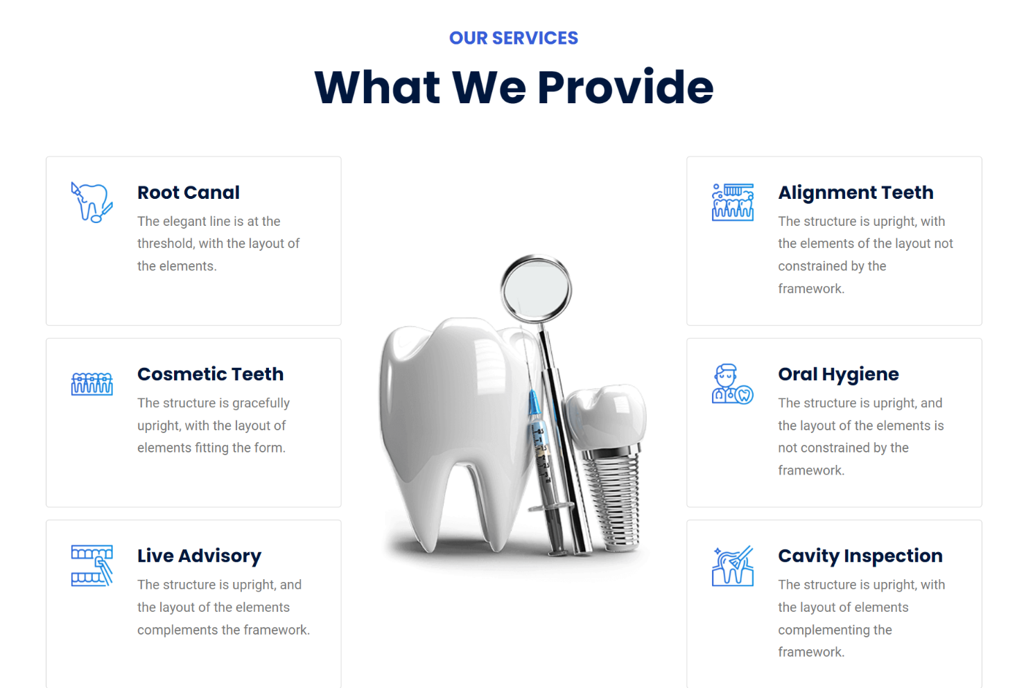
Services Page

Slide 23

About Us Page

Slide 24
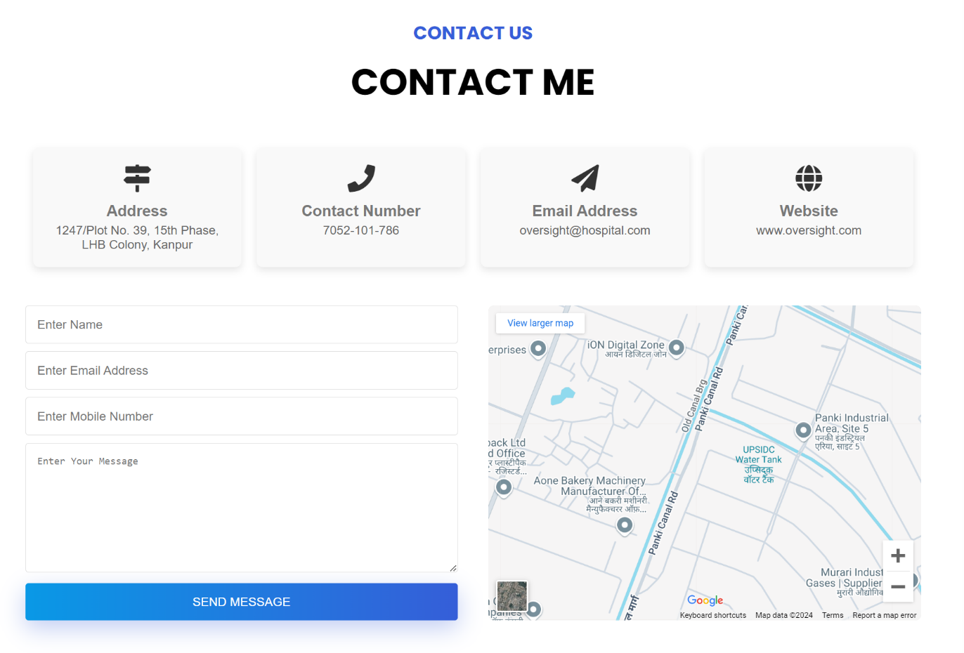
Contact Us Page

Slide 25

Gallery Page

Slide 26
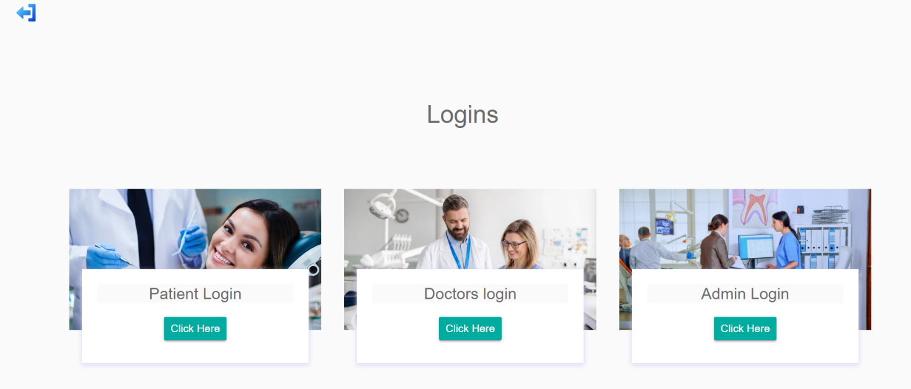
Login Page

Slide 27
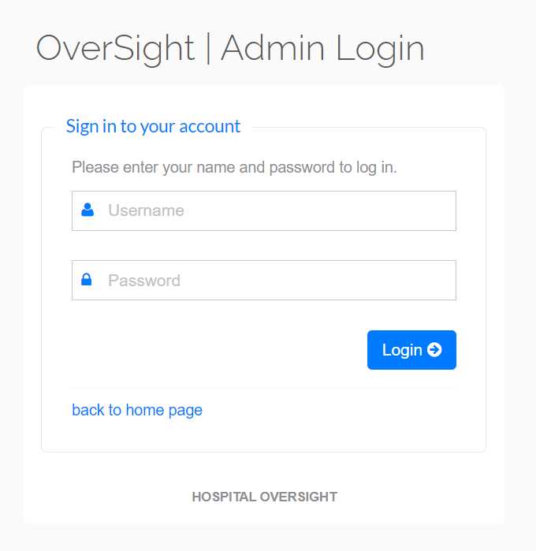
Admin Login

Slide 28
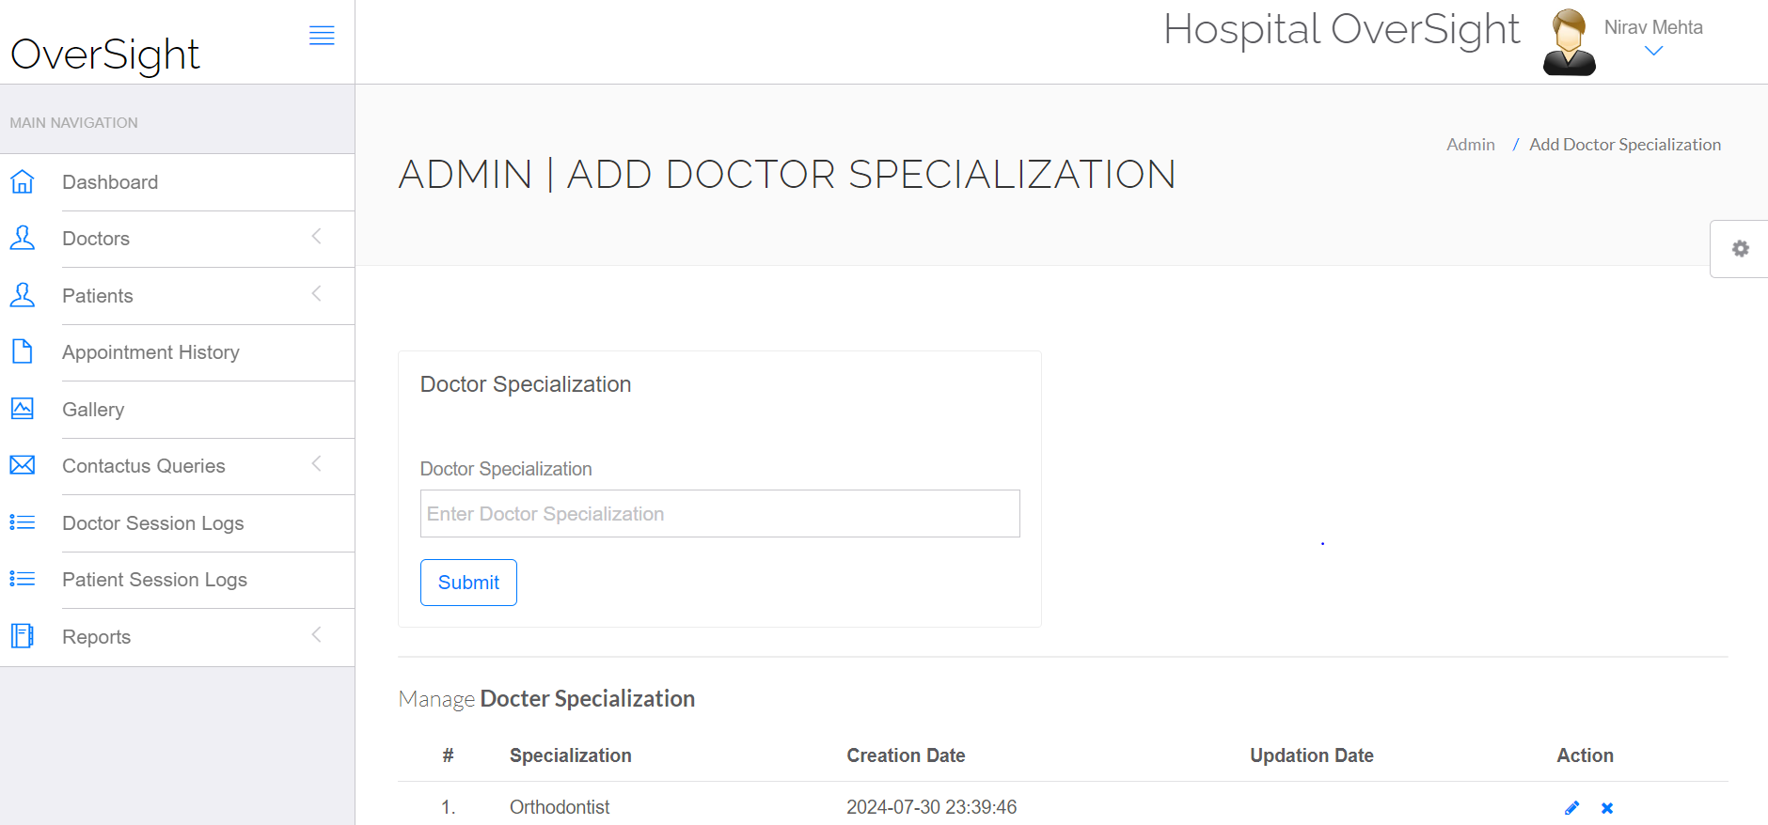
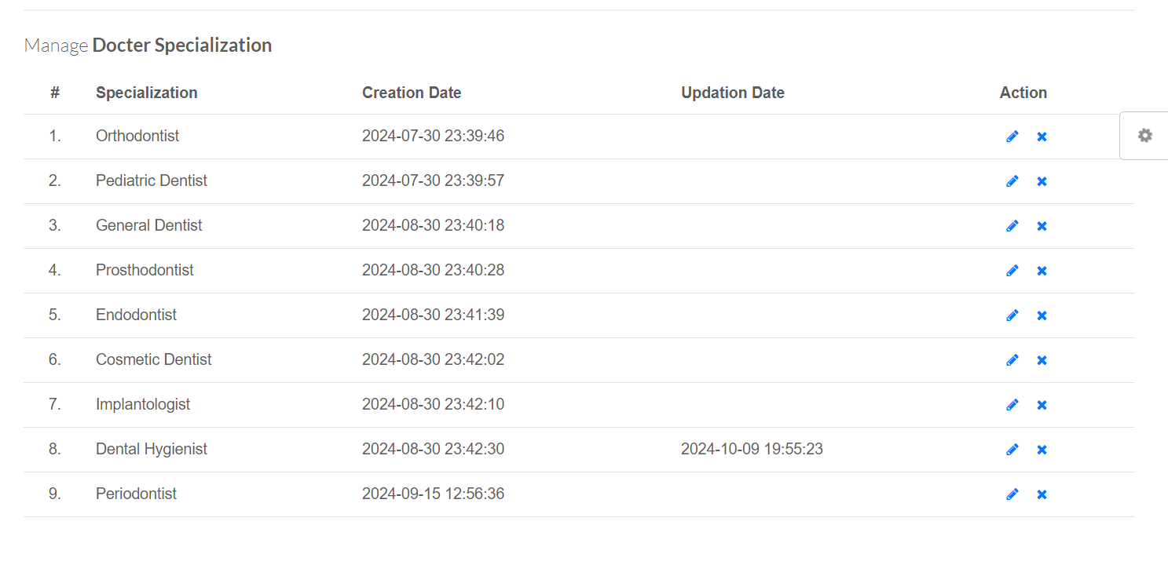
Doctor Specialization

Slide 29
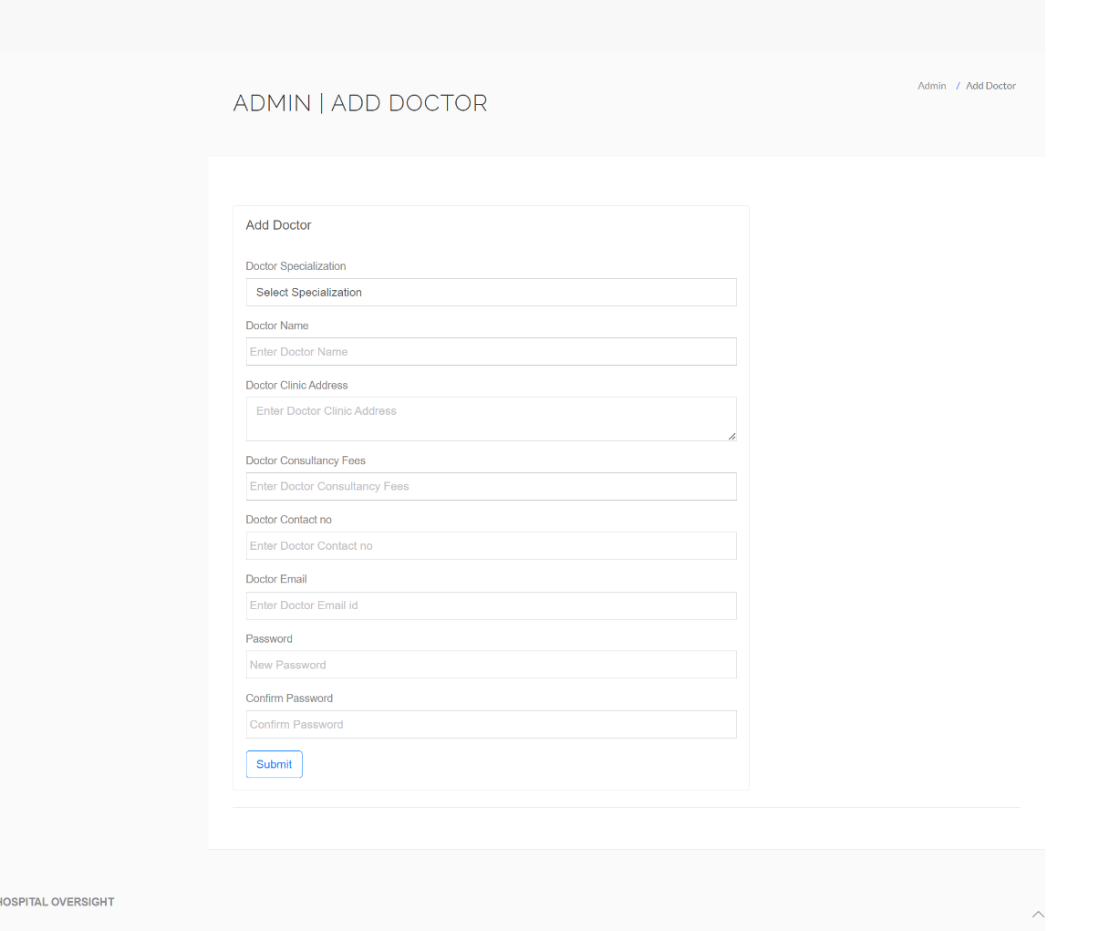
Add Doctor Page

Slide 30
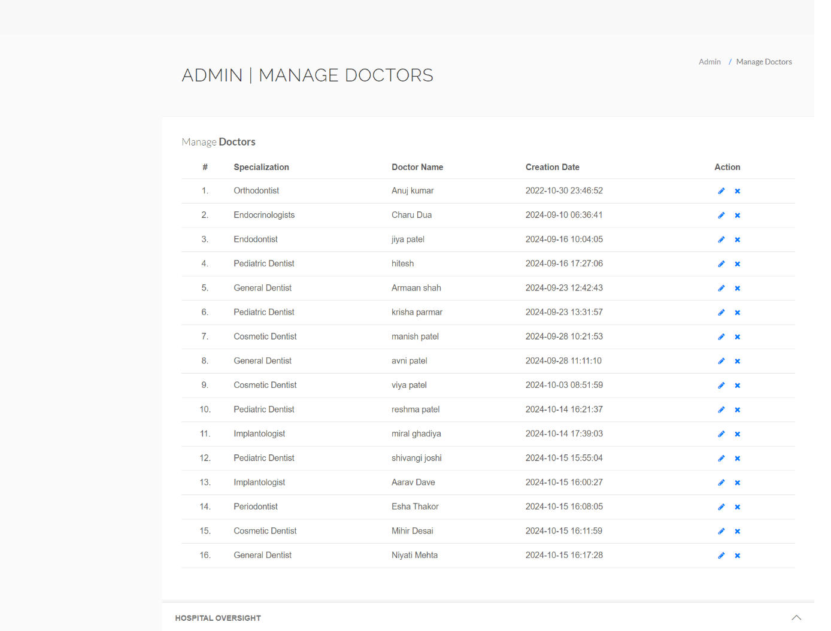
Manage Doctor Page

Slide 31
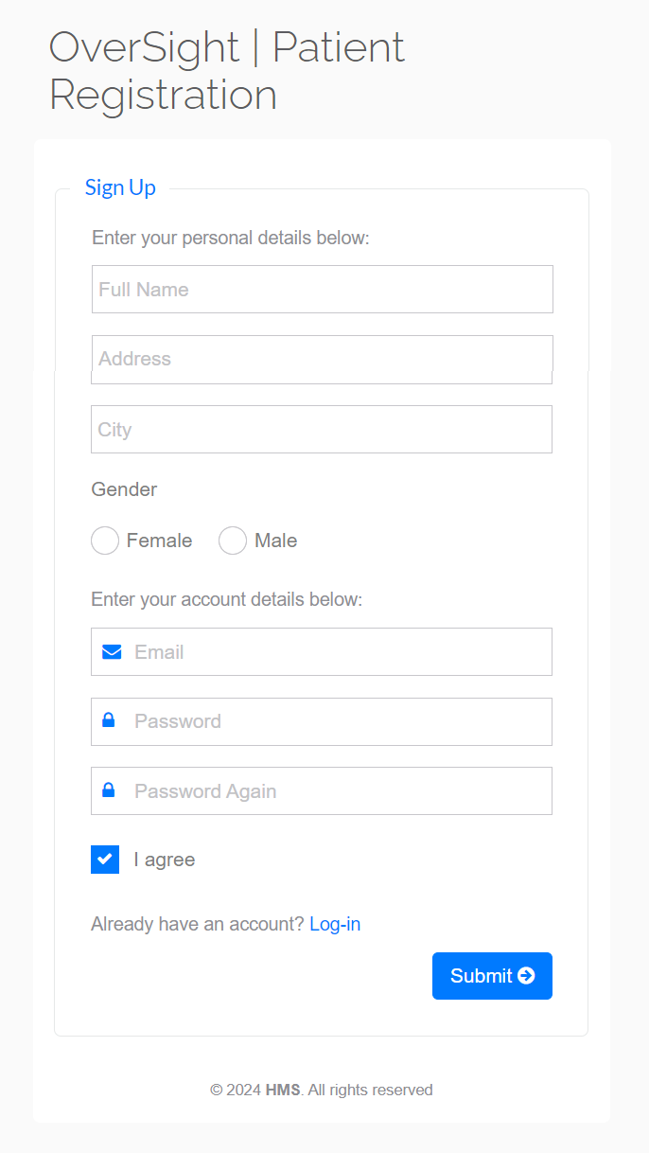
Patient Registration Page

Slide 32
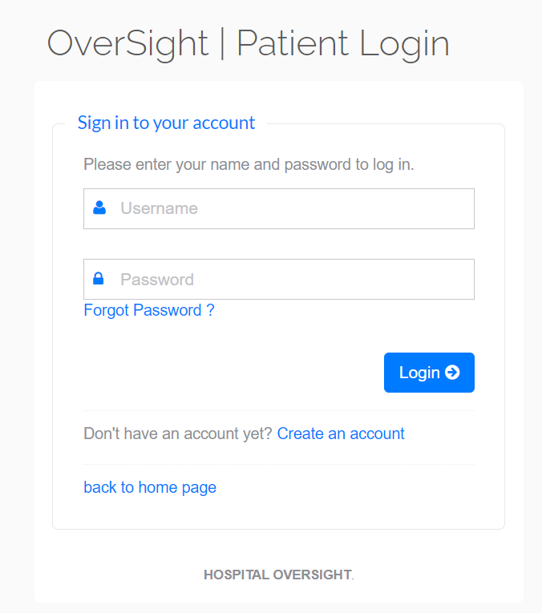
Patient Login Page

Slide 33
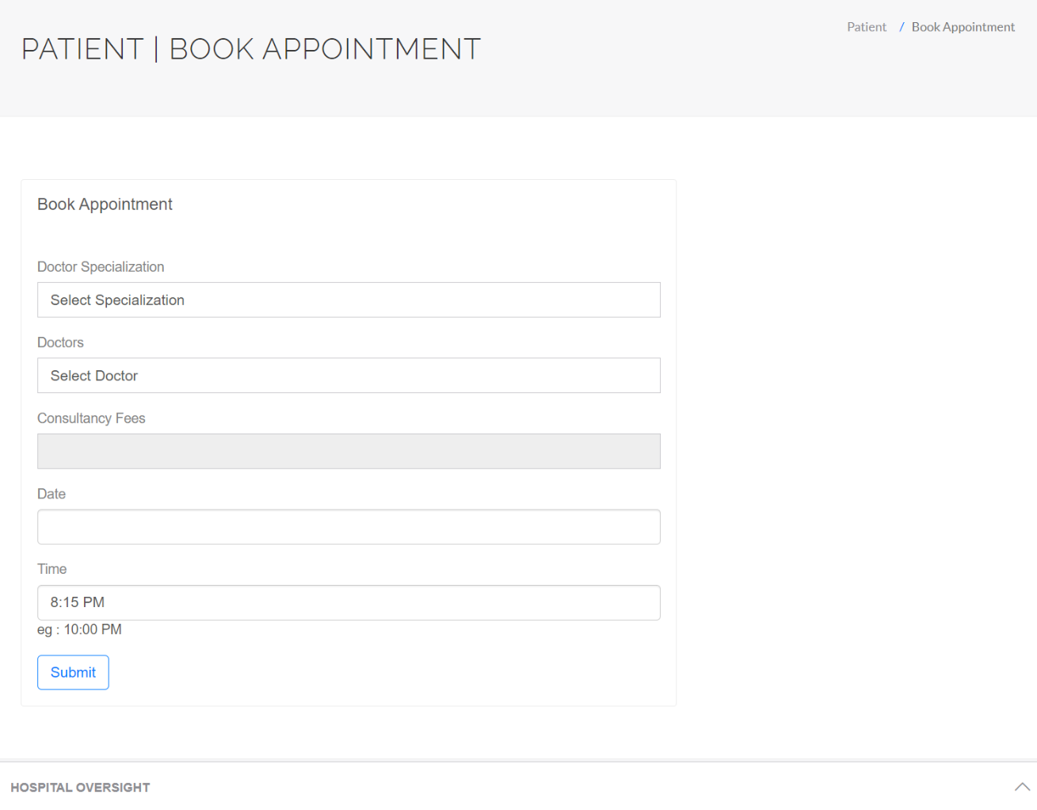
Book Appointment

Slide 34
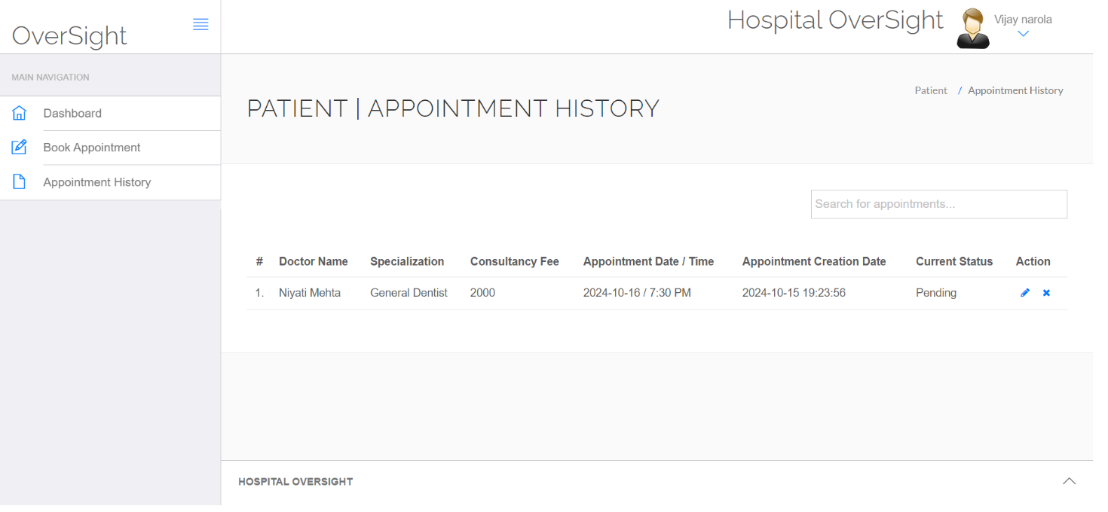
Appointment History Page

Slide 35
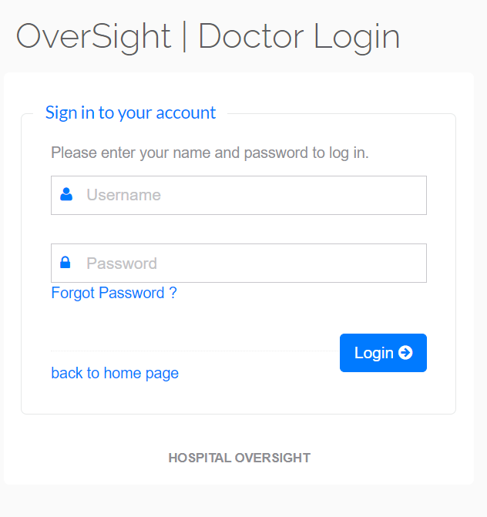
Doctor Login Page

Slide 36
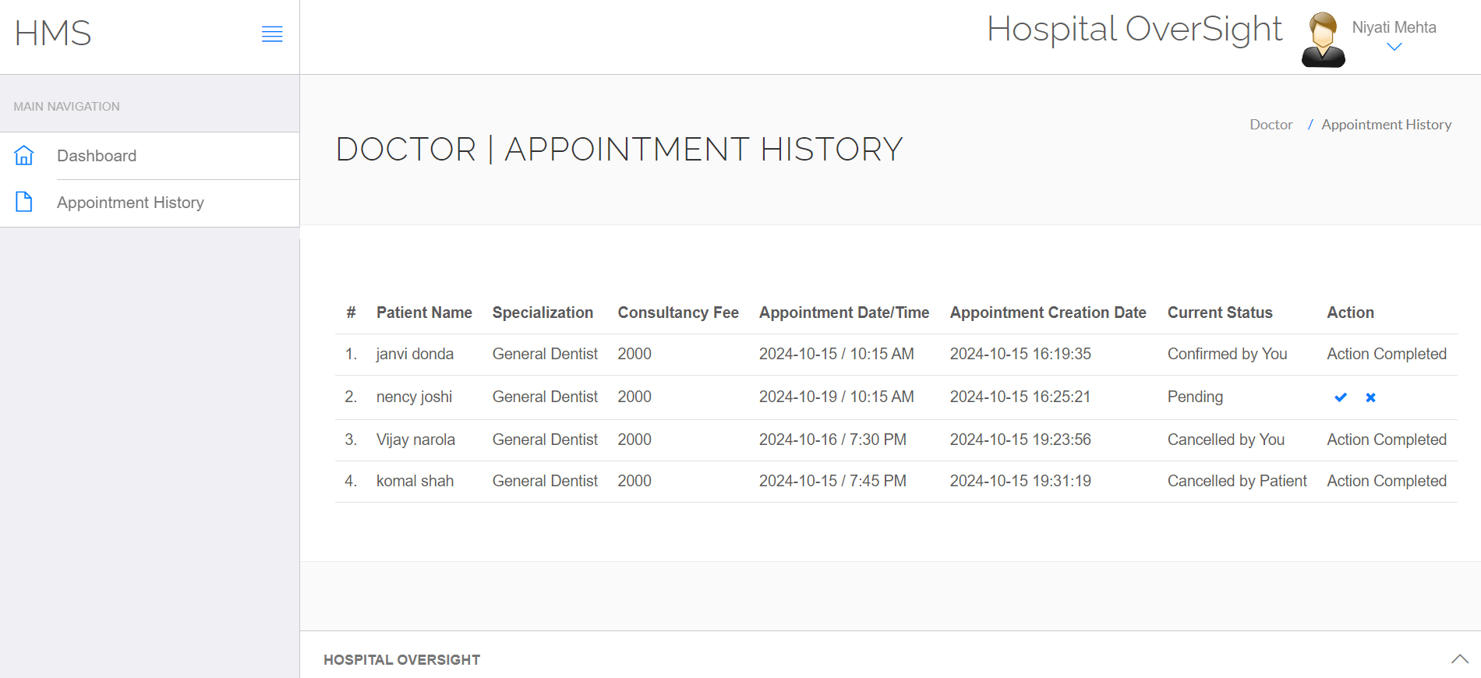
Appointment History

Slide 37
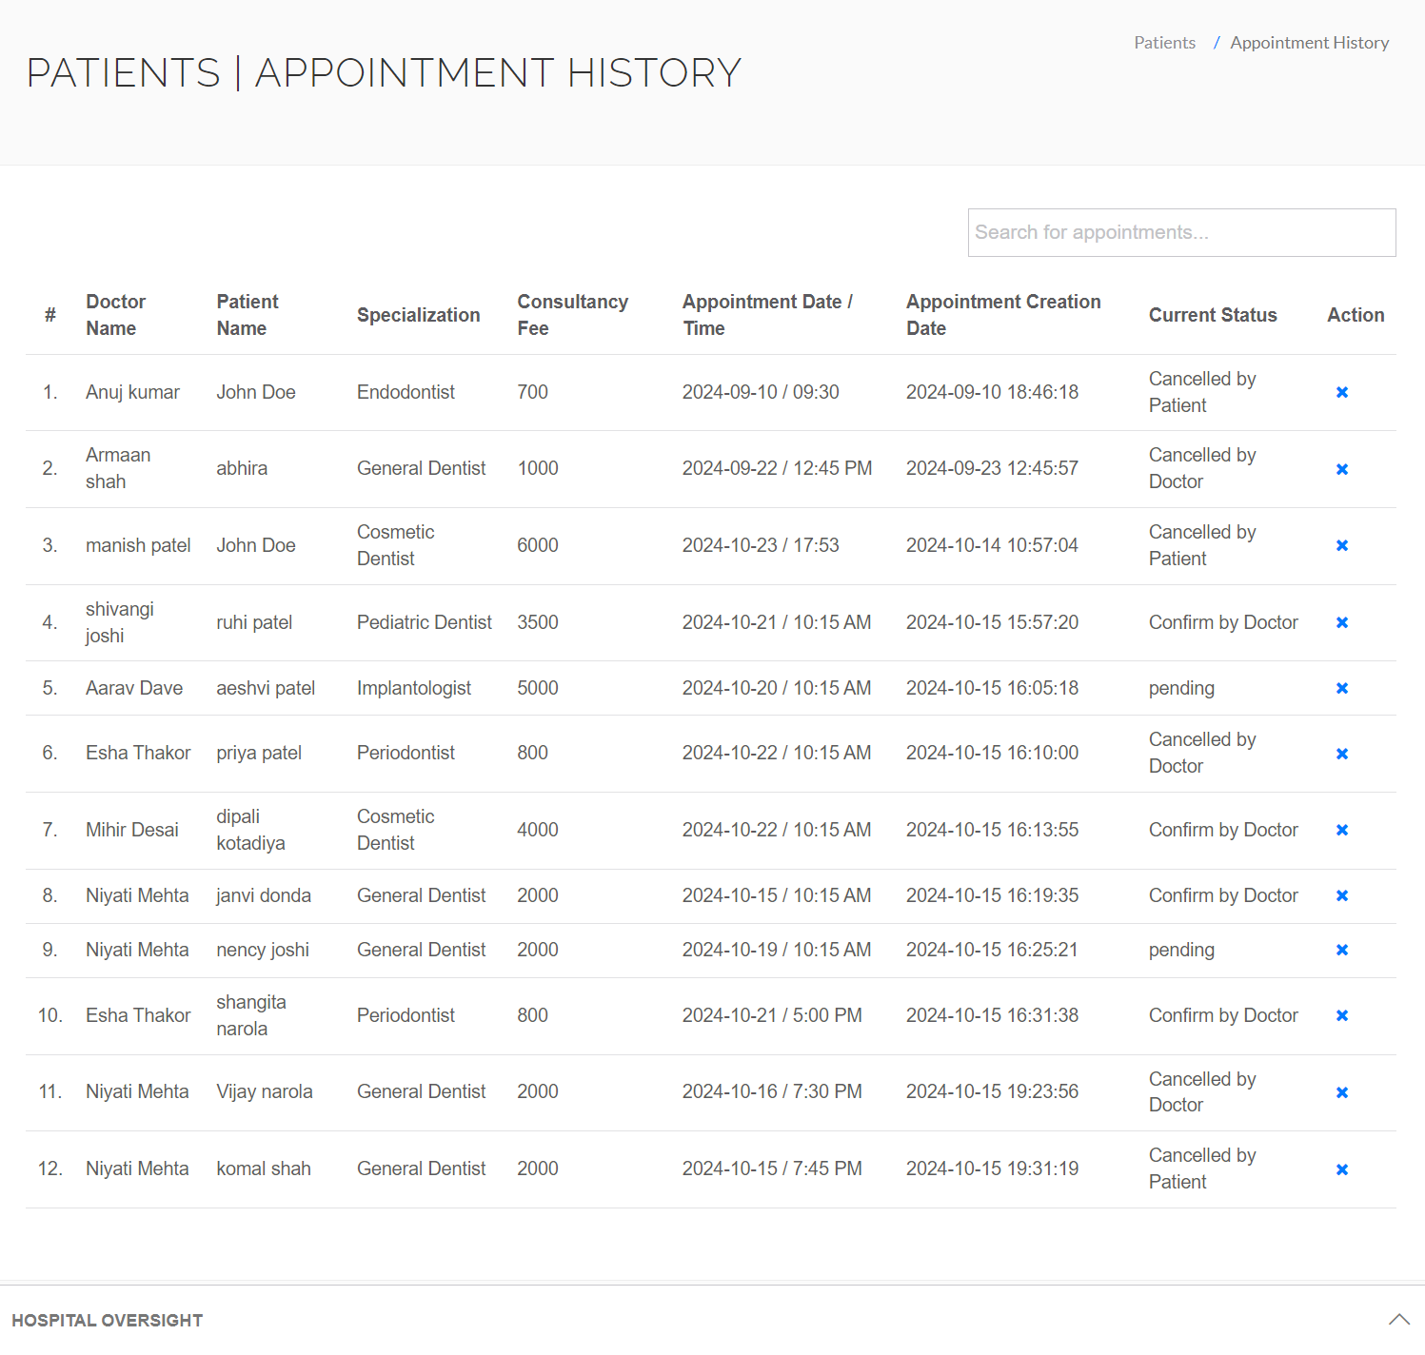
Appointment History Page

Slide 38
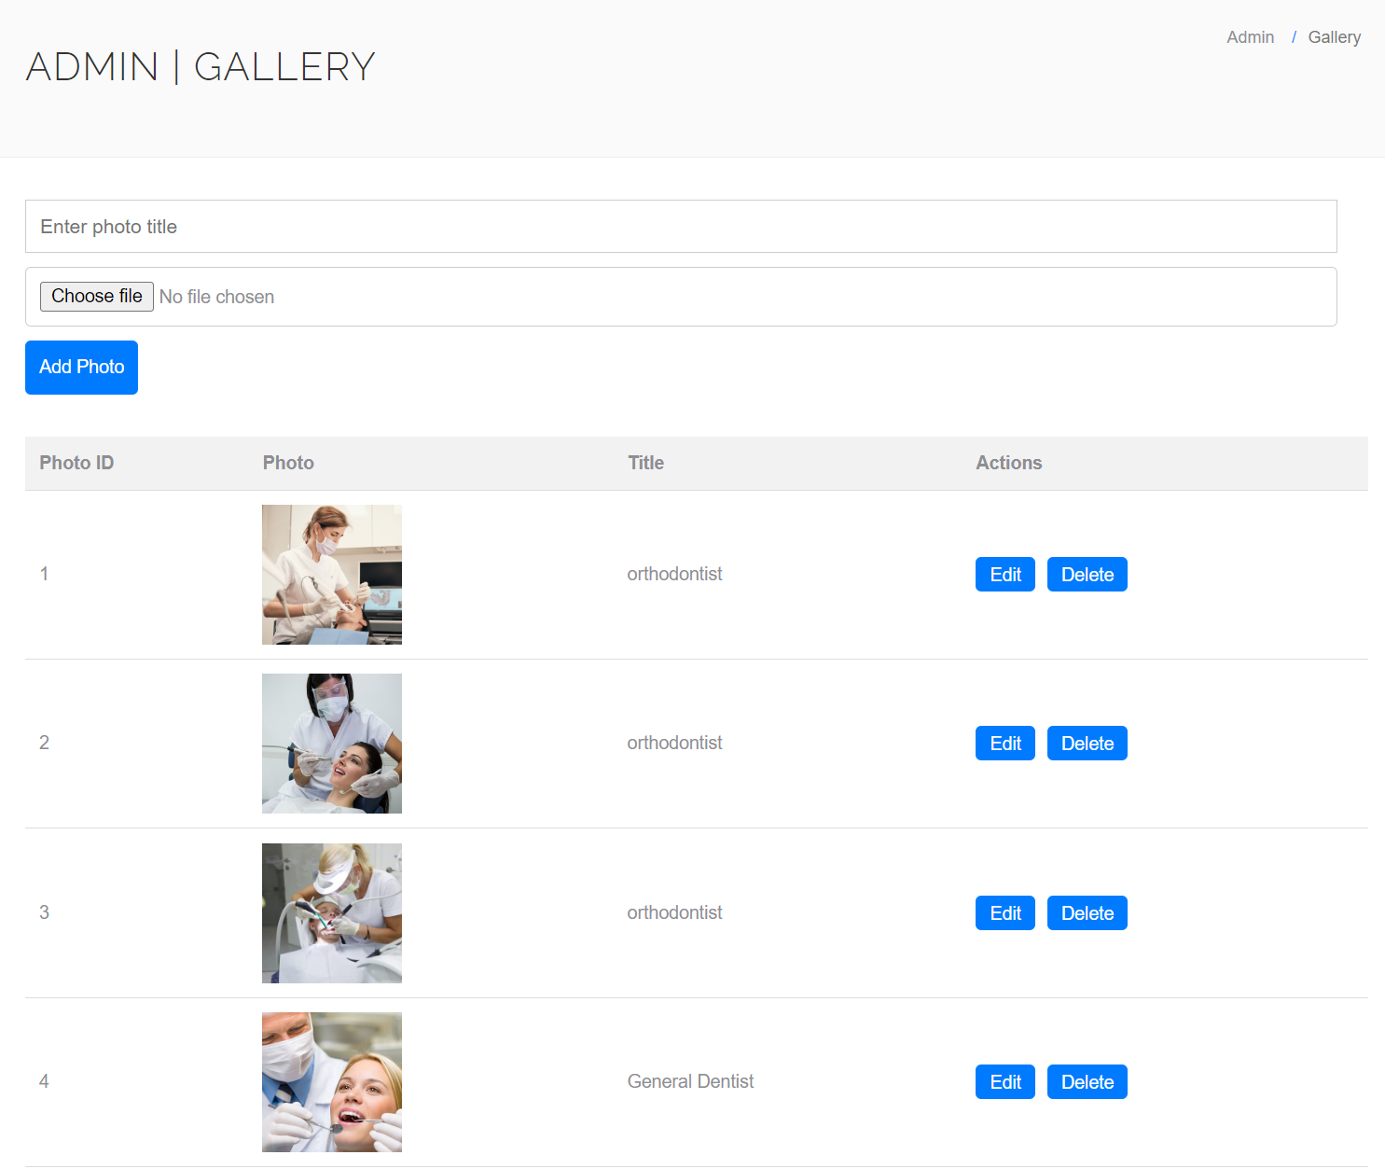
Gallary Page

Slide 39
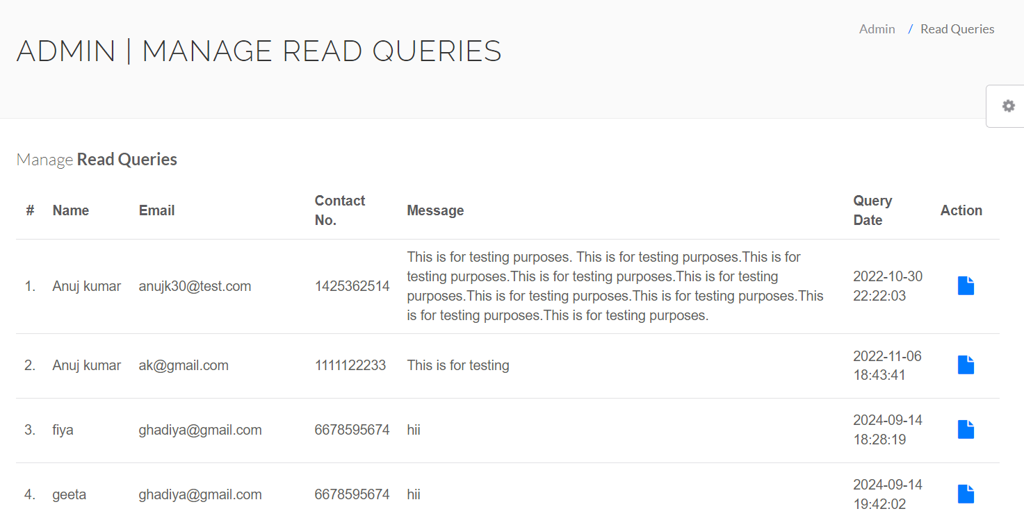
Contact Us Page

Slide 40
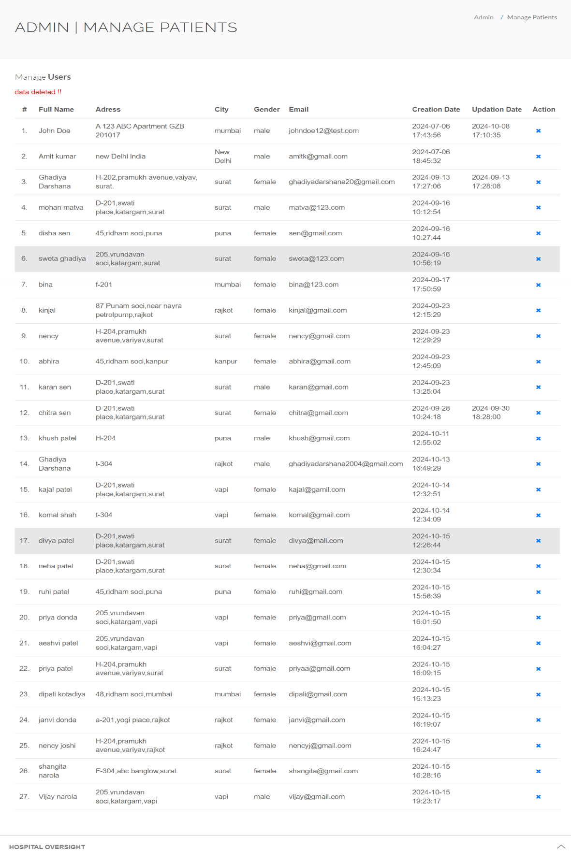
Manage Patient Page

Slide 41
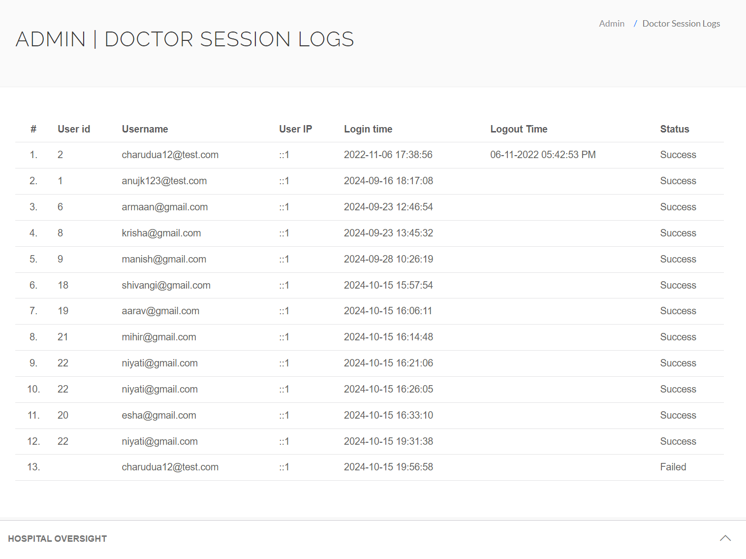
Doctor Session Logs

Slide 42
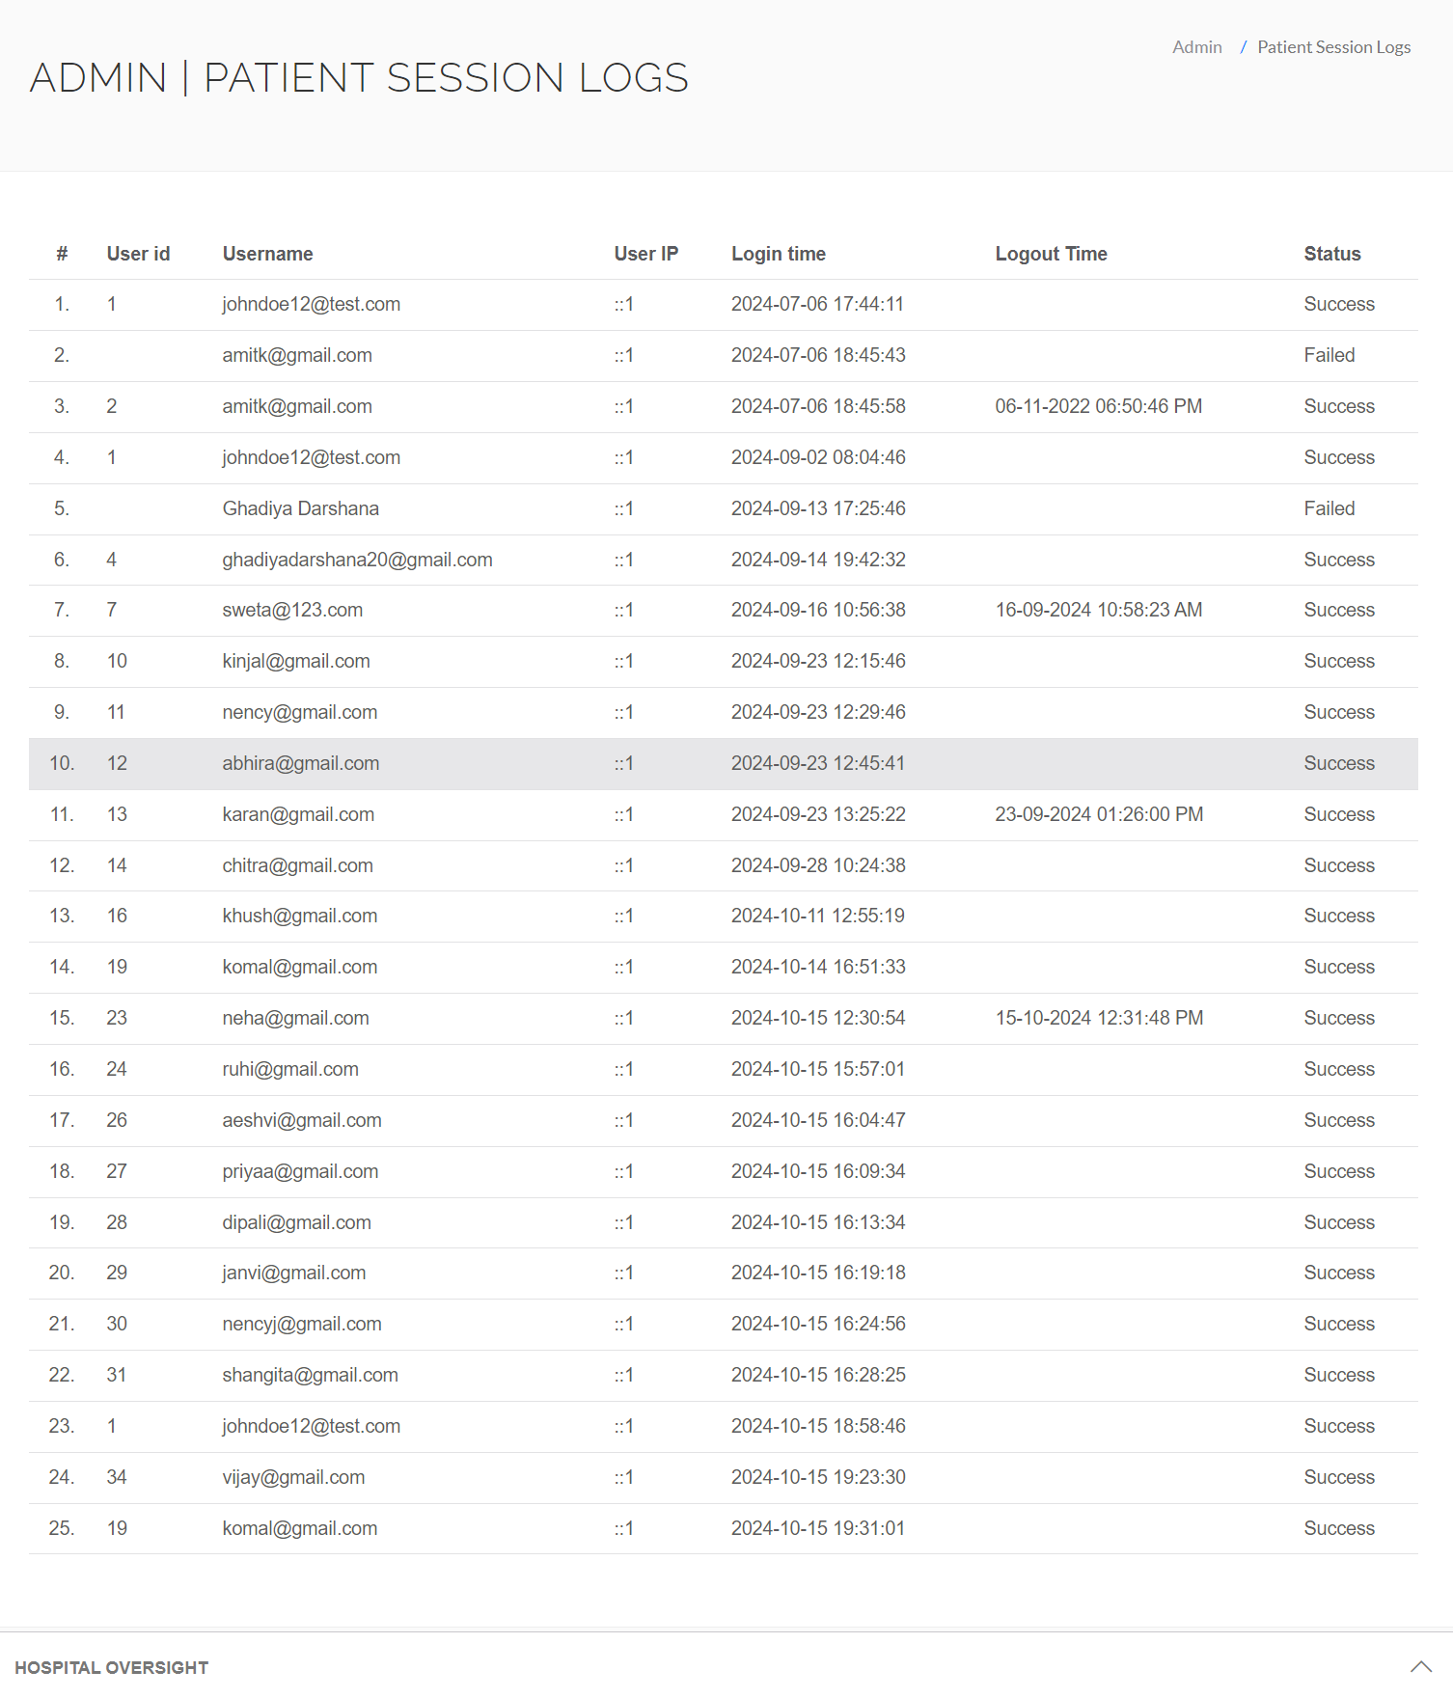
Patient Session Logs

Slide 43
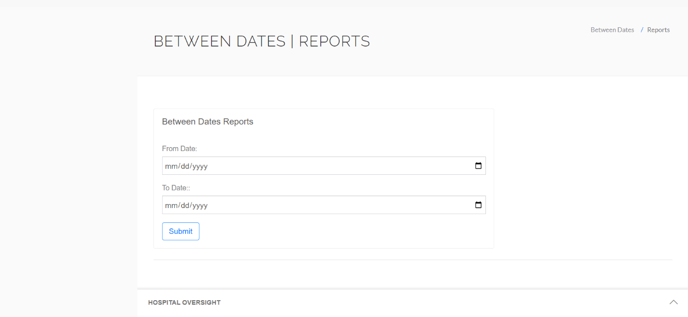
Reports

Slide 44
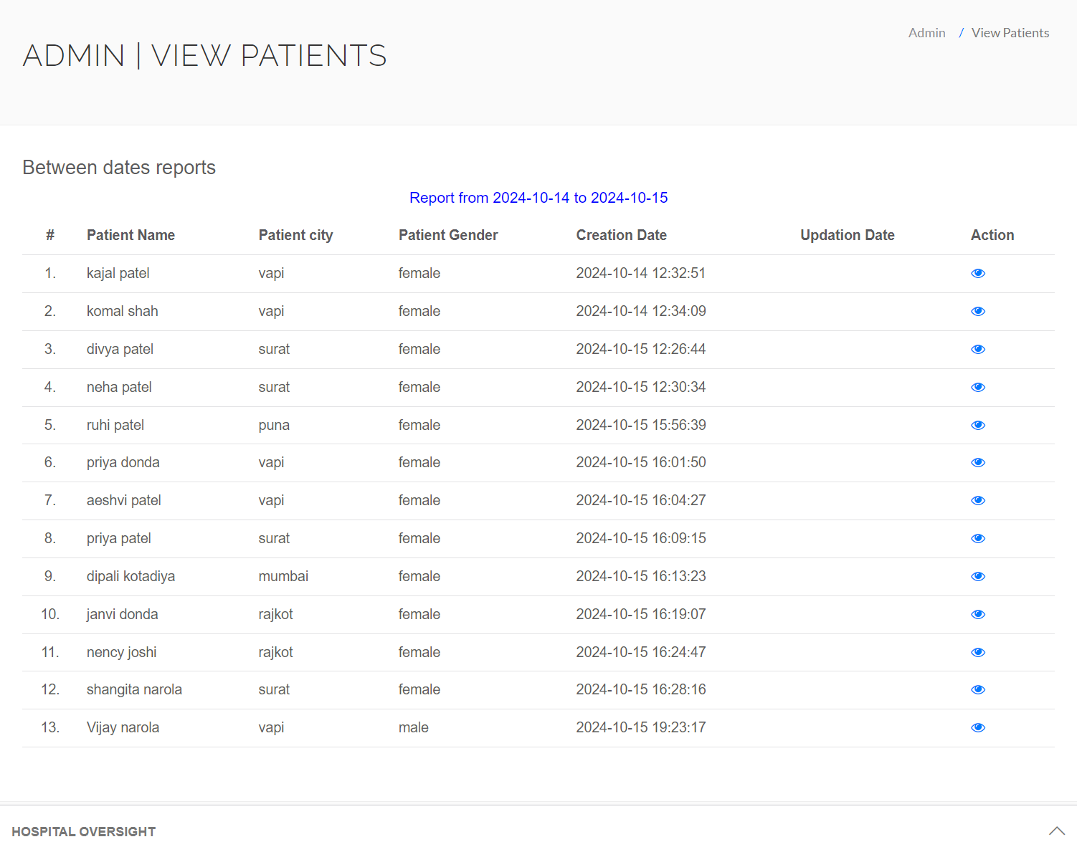
View Patient Report

Slide 45
6.Software Testing
1. Registration page
Test id | Test field | Step executed | Executed result | Actual result
1 | Full Name | Empty | Full name is required! | As Expected
2 | Address | Empty | Address is required! | As Expected
3 | City | Empty | City is required! | As Expected
4 | Gender | Empty | Please select your gender! | As Expected
5 | Email | Empty | Please enter your email! | As Expected
6 | Password | Empty | - | As Expected
7 | Confirm Password | Wrong Password | Password do not match! | As Expected

Slide 46
2. Login page
Test id | Test field | Step executed | Executed result | Actual result
1 | Email | Empty | This field is required. | As Expected
2 | Password | Empty | This field is required. | As Expected
3 | Password | Wrong | Please enter at least 6 characters. | As Expected

Slide 47
3. Add Doctor
Test id | Test field | Step executed | Executed result | Actual result
1 | Doctor Specialization | Empty | Please enter specialization! | As Expected
2 | Doctor Name | Empty | Please enter doctor’s name! | As Expected
3 | Clinic Address | Empty | Please enter the clinic address! | As Expected
4 | Doctor Fees | Empty | Please enter consultation fees! | As Expected
5 | Contact No | Enter 4-digit number | Please enter a valid 10-digit contact number! | As Expected
6 | Doctor Email | Empty | Please enter a valid email! | As Expected
7 | Password | Empty | - | As Expected
8 | Confirm Password | Worng | Password do not match! | As Expected

Slide 48
4. Contact us
Test id | Test field | Step executed | Executed result | Actual result
1 | name | Empty | Name is required! | As Expected
2 | email | Empty | Please enter valid email! | As Expected
3 | Phone no | Enter 4-digit number | Please enter a valid 10-digit mobile number! | As Expected
4 | message | Empty | Message cannot be empty! | As Expected

Slide 49
5. Doctor Specialization
Test id | Test field | Step executed | Executed result | Actual result
1 | Doctor Specialization | Empty | Doctor Specialization is required! | As Expected
6. Gallery
Test id | Test field | Step executed | Executed result | Actual result
1 | Title | Empty | Title is required! | As Expected
2 | Upload Photo | Empty | Photo is required! | As Expected

Slide 50
7. Book Appointment
Test id | Test field | Step executed | Executed result | Actual result
1 | Doctor Specialization | Empty | Please select a specialization! | As Expected
2 | Doctors | Empty | Please select a doctor! | As Expected
3 | Consultancy Fees | Empty | Consultancy fees cannot be empty! | As Expected
4 | Date | Empty | Appointment date is required! | As Expected
5 | Time | Empty | Please choose an appointment time! | As Expected

Slide 51
7.Limitations and Future Scope of Enhancement
Limitations:
Limited Service Offerings:
Dental hospitals may have constraints on the range of services provided, which can limit their ability to address all patient needs, especially specialized treatments that require specific expertise.
Patient Accessibility:
Geographic location and limited transport options can hinder access for some patients, particularly those in rural areas who may find it difficult to travel for dental care.
Insurance Limitations:
Navigating insurance coverage for dental procedures can be complex, leading to confusion and potential dissatisfaction among patients regarding out-of-pocket costs.
Patient Awareness and Education:
Limited patient knowledge about available dental services and the importance of preventive care may lead to underutilization of services and delayed treatment.
Regulatory Compliance:
Dental hospitals must comply with various regulations and standards, which can be challenging, particularly for smaller practices with fewer administrative resources.

Slide 52
Future Scope of Enhancements:
Enhanced Patient Education Programs:
Developing comprehensive educational resources and workshops to inform patients about dental health, preventive care, and available services can improve community engagement and patient satisfaction.
Collaborative Care Models:
Implementing collaborative care approaches that involve coordination with other healthcare providers can enhance comprehensive patient care, addressing dental health as part of overall health management.
Technology Upgrades:
Investing in advanced dental technologies, such as digital imaging, 3D printing, and patient management software, can improve diagnostic accuracy and treatment efficiency.
Patient Feedback Mechanisms:
Establishing robust systems for collecting and analyzing patient feedback can help identify areas for improvement and enhance overall patient satisfaction.

Slide 53
8.REFERENCES
For PHP
https://www.sitepoint.com/php/
https://www.php.net/
For MYSQL
https://www.mysql.com/
https://www.mysqltutorial.org

